Slide 1



WHOLE PERSON CARE: Toward precision psychiatric support of individuals with dual diagnosis
(Developmental and behavioral disability)
John N. Constantino, M.D.
Intellectual and Developmental Disabilities Research Center
Washington University School of Medicine, St. Louis, Missouri
Missouri DMH Dual Diagnosis Task Force

Slide 2
https://link.springer.com/article/10.1007/s11920-020-1127-8
Current Psychiatry Reports, February 2020 Issue
ID / ASD – Depression, Aggression (Psychosis, Cycling Mood), Anxiety (PTSD), ADHD (Impulse Control Disorders)

Slide 4
Recognition of dual diagnosis
Constantino and Magnusson, J Dev Behav Pediatr 2011

Slide 5
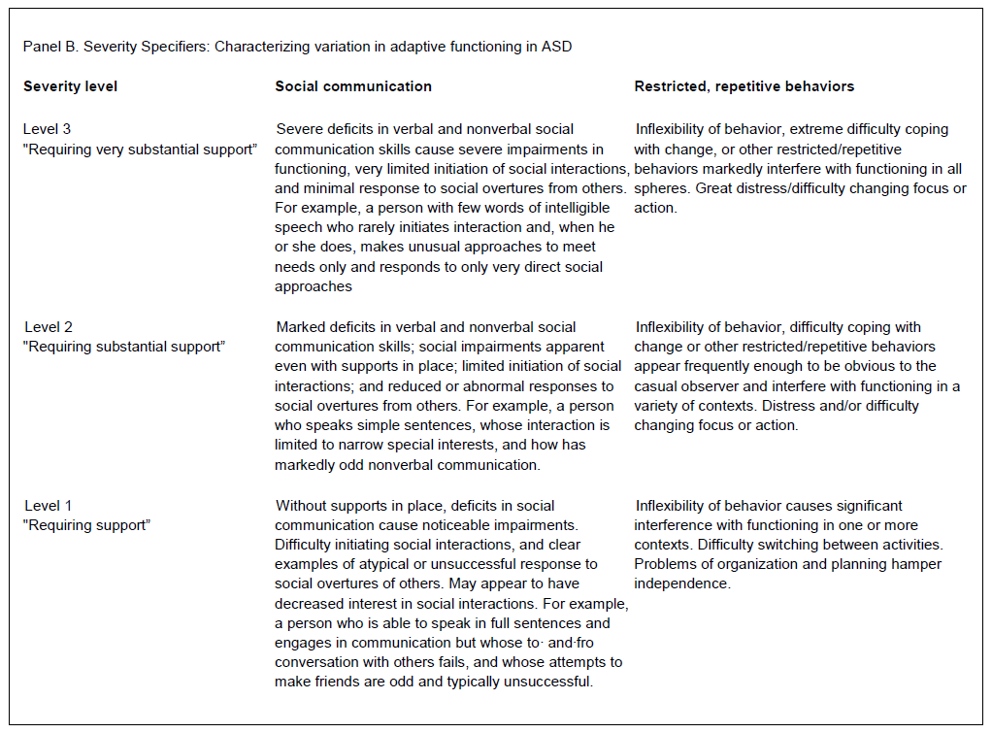
Adaptation

Slide 6
Precipitating Factors

Slide 7
Intervention relevant to both DD and BH
Positive Behavior Support
Case Management
In-home support
Psychopharmacologic Intervention
  Impulse Control
  Mood Stabilization
  Psychosis
  Aggression

Slide 8
Comprehensive appraisal and treatment of depression in a young adult with intellectual disability
Diagnosis: Recognition of symptomatology
  Change in level of functioning
    Withdrawal
    Loss of Skills
    Isolation
Biological Precipitating Factors
  “Endogenous Depression”
    Family Psychiatric History
    Specifiable Genetic Syndrome
Psychosocial Factors / Educational / Vocational Context
  Loss (disruption of support, actual or perceived)
    Social History
Treatment Considerations
  Compensatory Skills Training
  Communicative Capacity
  Specific Interventions
    Positive Behavior Support
    Cognitive Behavioral Therapy
    Psychopharmacology
    Vocational Opportunity
What proportion of ID-dep patients receive all?

Slide 9
Comprehensive appraisal of aggression in a young adult with autism
BIOLOGICAL FACTORS: Complicating medical or psychiatric syndromes
  ADHD present or absent?
  Depression present or absent?
  Anxiety present or absent?
  Psychosis present or absent?
PSYCHOSOCIAL Factors: Status of identity / relation to the environment
  Agency, Role, Connection / Inclusion
  Address Behavioral triggers / precipitants (Functional Behavior Analysis)
  Status of Village of Support
  Address gaps in critical aspects of interpersonal communication (Functional Communication)
  Address necessary level of externally-imposed structure/support (least restrictive environment).
TRAUMA
  Post-traumatic stress disorder profile?
Are all individuals with autism and aggression receiving these aspects of consideration / support?

Slide 10
Comprehensive treatment of aggression in a young adult with autism
SOCIAL SERVICES: Ensure necessary support of caregiving environment to meet essential needs
MEDICAL Rule out temporal lobe epilepsy
EDUCATIONAL: Optimize IEP
Positive Behavior Support Plan (DD)
Family Support / Effective Respite (DD)
Psychotherapy / In-home Support (BH)
Psychopharmacologic Options (BH)
  Alpha Agonists
  Mood Stabilizers
    Anticonvulsants
    Antipsychotics
    Lithium
When necessary, functional communication training
Are all individuals with autism and aggression receiving these aspects of consideration / support?

Slide 11
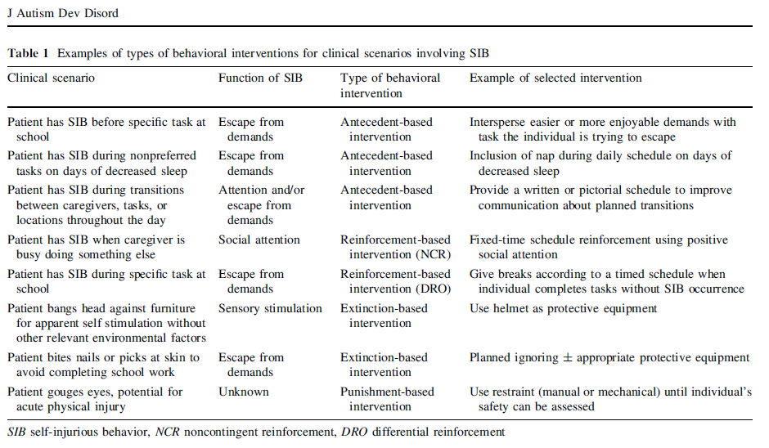

Slide 14

Move knowledge, not people...
Project ECHO is committed to addressing the needs
of the most vulnerable populations by equipping communities with
the right knowledge, at the right place, at the right time.
Case-based learning

Slide 15
ECHO 1: 16 year old female who is at risk of losing a placement: unmanageable sexual compulsion / agitated tirades over management of screen time
1) Confirm the list of previous medication failures and commence a strategy of short-term pharmacologic intervention for florid impulse control problems that respond to major gaps in her treatment history; would specifically consider Adderall (requires a trial of a few days to determine efficacy), Lithium (requires a trial of 7-10 days to determine efficacy), followed by increasing Abilify and successive trials of Lamotrigine and/or ECT.
2) Implementation of a comprehensive positive behavior support plan (ABA-based) surrounding internet and phone use. This would include consideration of both the motivating and toxic (addictive) features of each; control of access and passwords, goals and consequences regarding boundaries related to their use (eg. consequences for destructive/agitated behavior when time is up for perusing internet).
3) Accentuation of individual psychotherapy with a distinct objective of uncoupling sexual interests / pursuits from repetition compulsion for trauma/victimization. This is a 16 year old with autism who is making frantic attempts to place herself in unsafe/objectified sexual situations that she has no control over. This lack of control is an immediate threat to her and to her placement, and in prior placements in which there was adequate structure, taking this "off the table" appears to have been stabilizing to her. Therefore establishing very clear boundaries and consequences regarding sexual indiscretions need to be built into her positive behavior support plan.

Slide 16
A new app for clinical decision support!

Slide 17
Depression→ Psychological and Social Factors→ Existential Conflict
For individuals with adequate cognitive capacity (mental age of approximately 8 years or greater), existential crises comprise a set of specific adjustment disorders that are commonly encountered in adolescence in neurotypical individuals and are associated with depressed mood. The themes of existential crises tend to revolve around concerns pertaining to:
Mortality (fear of death or denial of death by risk-taking)
Meaninglessness (concern that limitations of one’s ability severely jeopardize meaning or purpose
Isolation
Dread of choice (opportunity to make major decisions may become increasingly available with advancing age but these opportunities are experienced as overwhelming)
Perception that agency / capacity to direct one’s own course, has been violated (the notion of being controlled or “managed” as if a puppet). Here the well-documented role of learned helplessness and its direct depressogenic effects applies.
Here again, the intervention approach must include addressing the existential concern being experienced by the client, rather than assuming that he/she is incapable of formulating or struggling with such concerns. See https://jaacap.org/article/S0890-8567(20)30351-8/fulltext

Slide 19
→Consider Unresolved Trauma
Children and families may be hesitant to report trauma concerns because of several factors, including close family ties and attachment, power differentials (e.g., perpetrator controlling child’s basic needs), caregiver feelings of inadequacy, victim self-blame or embarrassment, grief and loss, cultural factors, concerns for exacerbating child/family stress, and caregiver burnout (Ko, 2015) A wide range of signs and symptoms might raise flags for the possible presence of traumatic stress, including suspicious physical injuries (bruises, burn marks, etc.), abrupt unexplained changes in mood/behavior or regression in adaptive functioning, emergence of specific fears or avoidance, concerning new behaviors that are inappropriate for an individual’s developmental level, abrupt unexplained disturbances in sleep and feeding, and direct/indirect self-disclosures. Trauma exposure is 2-4 times more likely for individuals with IDD (Cross, 1993). Youth with IDD are up to 4 times more likely to witness family domestic violence in comparison to their peers (Sobsey, 1995). Externalizing behavior, which has a greater incidence among children with intellectual disabilities, appears to be related to an increased risk of physical abuse (Gerstein, et al., 2011). Internalizing behavior or communication and learning problems are associated with increased risk of sexual abuse (Turner, 2011). During adolescence, the sexual development of children with IDD is often misunderstood or stereotyped as asexual or hypersexual which may increase the risk of exposure to sexual abuse. Treatment ideally focuses on gradually improving an individual’s ability to engage in core adaptive, educational/vocational and social activities successfully without experiencing intrusive symptoms and other distress. Successful treatment and service delivery must recognize and address trauma histories and avoid re-traumatizing through coercive or violent interventions such as seclusion, restraint, and forced medication (Poindexter, 2002). Individuals with dual diagnoses that are admitted to inpatient acute care are at significant risk for long-term institutionalization (Jacobson, 2002) least restrictive options should always be attempted first to decrease the potential for re-traumatization.

Slide 20
Aggression→ Safety Concerns Specific to Aggression
The following are mandatory components of safety crisis planning and implementation: Identification of situations that are likely to trigger or prevent crisis situations Identification of precursor behavior that signals that crisis behavior is imminently likely to occur Identification of safe strategies that have worked in the past or might work in the future to prevent or resolve crisis situations Development of a specific plan of strategies to prevent and respond to challenging situations that includes WHO will response, WHAT they will do, WHEN they will do it, and HOW LONG they will keep it up. Includes the point at which additional assistance should be sought Persons who are likely to physically intervene during an aggressive episode should receive training in formally recognized/approved physical crisis management (e.g., Crisis Prevention training (CPI) ™, the MANDT™ system, Professional Crisis Management (PCM)™, Safety Care™, etc.). The support team should consider potential physical safety equipment if necessary (e.g., pads) that may be useful during events. The support team should communicate and collaborate with law enforcement and hospitals to ensure consistent and “safe” responses In situations involving self-injury, the support team should arrange for frequent medical evaluation to assess and treat medical trauma resulting from self-injurious actions While crisis and safety planning are important, they do not equate to treatment, rather necessary steps to establish a climate in which treatment can meaningfully occur and have a chance to succeed.

Slide 21
Aggression→ Comprehensive Intervention→ Biological Therapies (Psychopharm)
Typically pharmacological treatment proceeds similarly as it would for aggression in psychiatric syndromes exclusive of IDD Mood stabilizing agents (lithium, atypical neuroleptics, and anticonvulsant mood stabilizers) are most effective, but carry a diversity of short and long term risks. Risperidone and Aripiprazole have the strongest evidence in reducing aggression and irritability in IDD Consequently, it may be prudent to consider stimulants and alpha agonists as first approaches, especially in IDD syndromes in which aggression may be attributable to ADHD or unspecified impulse control problems; this is particularly common in the autism spectrum disorders and represents a significant opportunity for safe, effective amelioration of disruptive behaviors. Anxiolytics can be considered for patients whose aggressive episodes occur in the context of unresolved anxiety, with the caveat that drugs in this class can be disinhibiting and thereby exacerbate aggression in some patients, requiring appropriate caution. For ASD patients who have not responded to other antipsychotics, Clozapine has been reported to be an efficacious and well-tolerated treatment.

Slide 22

THANK YOU

