Slide 1
PROMOTING INCLUSION:
A Culturally Responsive Toolkit
for Health Professionals that
Work with Transition Age Youth

Slide 2
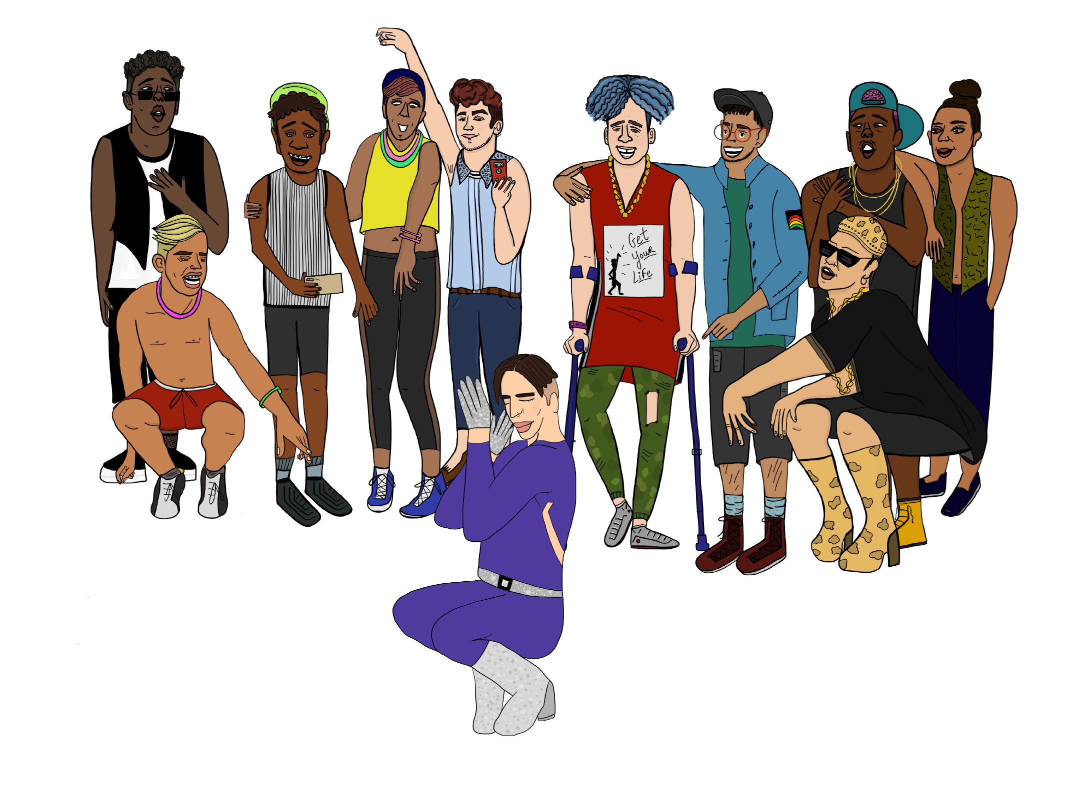
WELCOME!

Slide 3
TODAY’S AFY TEAM
Armonté (He/Him)
Senior Manager, LGBTQ Health & Rights
Louie (He/Him)
Director, LGBTQ Health & Rights

Slide 6
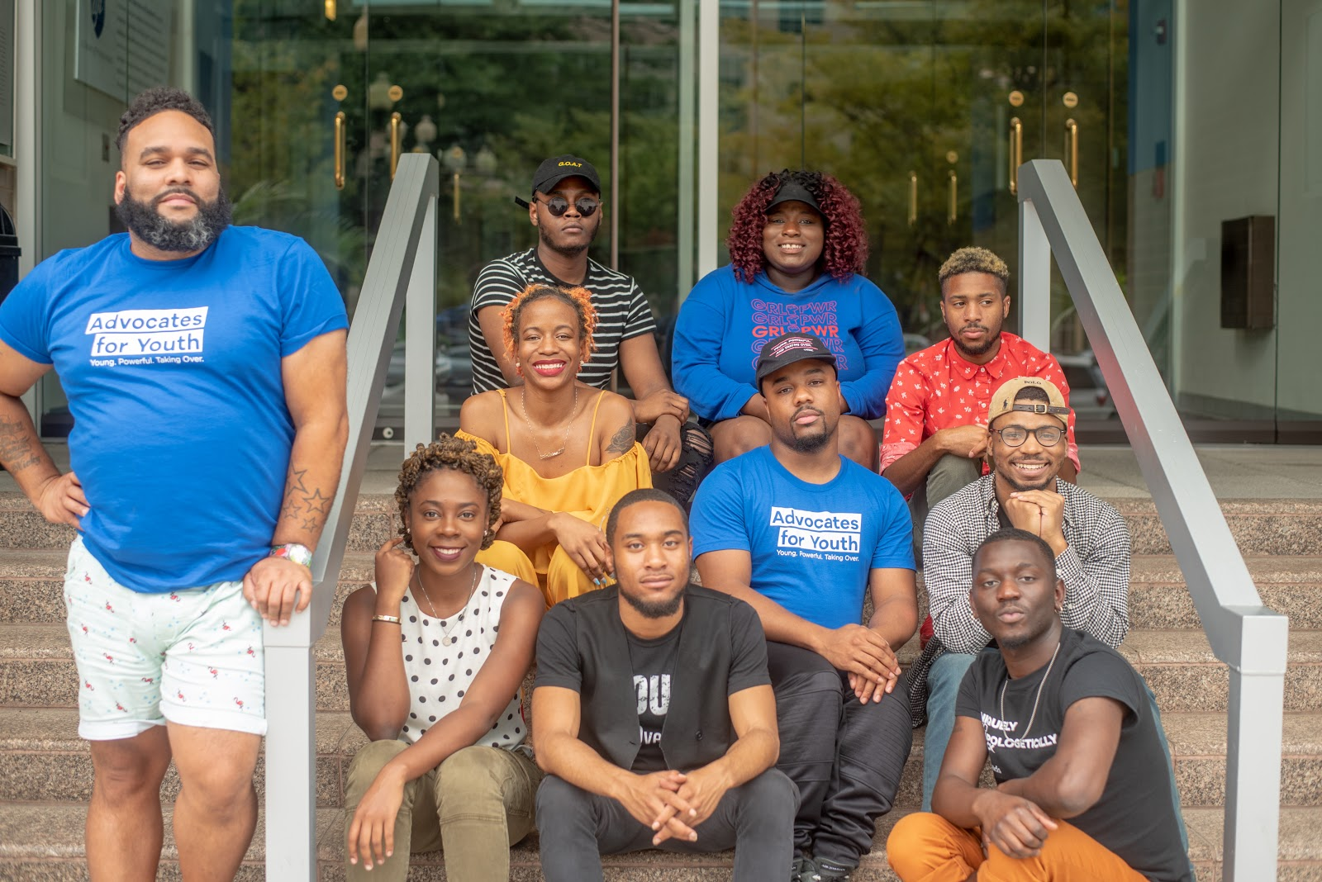
ECHO
ENGAGING COMMUNITIES
AROUND HIV ORGANIZING

Slide 7
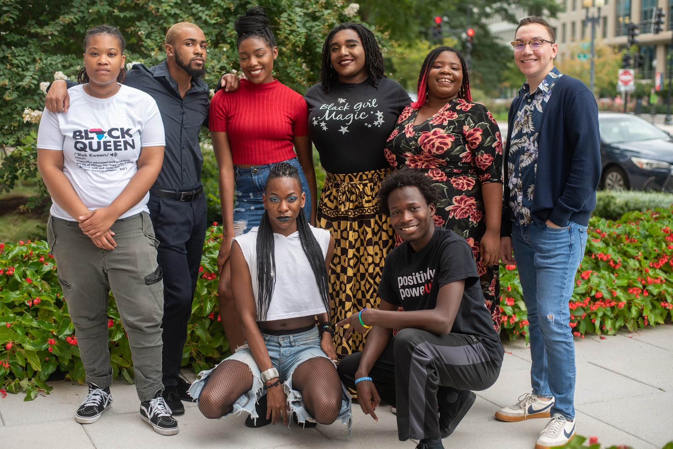
YOUTHRESOURCE

Slide 8
NO “RIGHT”
NO “WRONG”

Slide 9
INTRODUCTIONS
NAME
PRONOUN
ONE THING YOU ENJOY ABOUT SUMMER

Slide 10
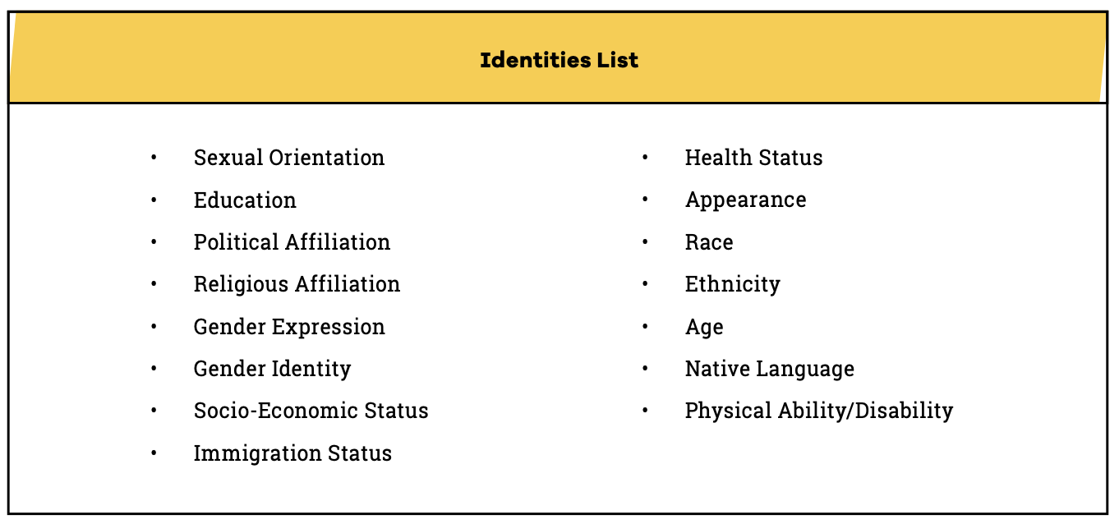
IDENTITY ACTIVITY

Slide 11
CHOOSE THE IDENTITY THAT
YOU FEEL THE MOST SAFEST?

Slide 12
CHOOSE THE IDENTITY THAT
YOU FEEL THE LEAST SAFEST?

Slide 15
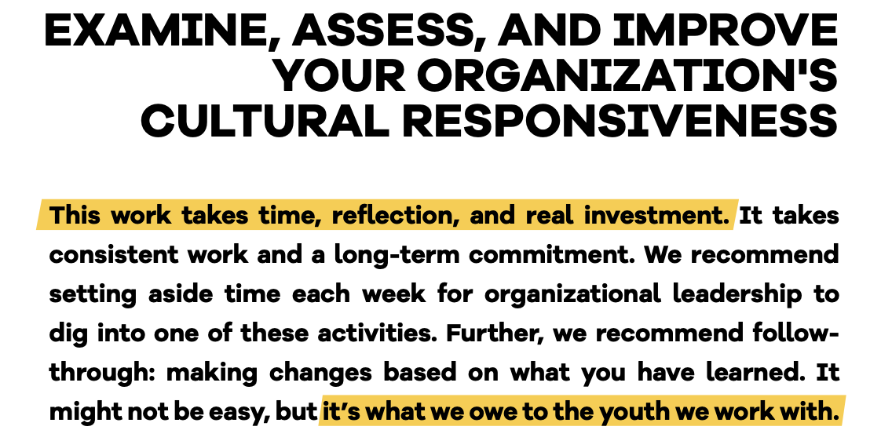

Slide 16
Work on becoming self-aware
Begin to analyze ourselves
Take concrete steps
Considerations

Slide 17
1. Be Clear about Your Own Attitudes and Biases
2. Understand How Discrimination, Including Racism,
Homophobia, and Transphobia Affect Youth
3. Take Action to Ensure All Young People Feel Affirmed at Your
Organization.
4. Support Youth and Staff in Your Agency to Be in Support of
Young People from Marginalized Backgrounds

Slide 18
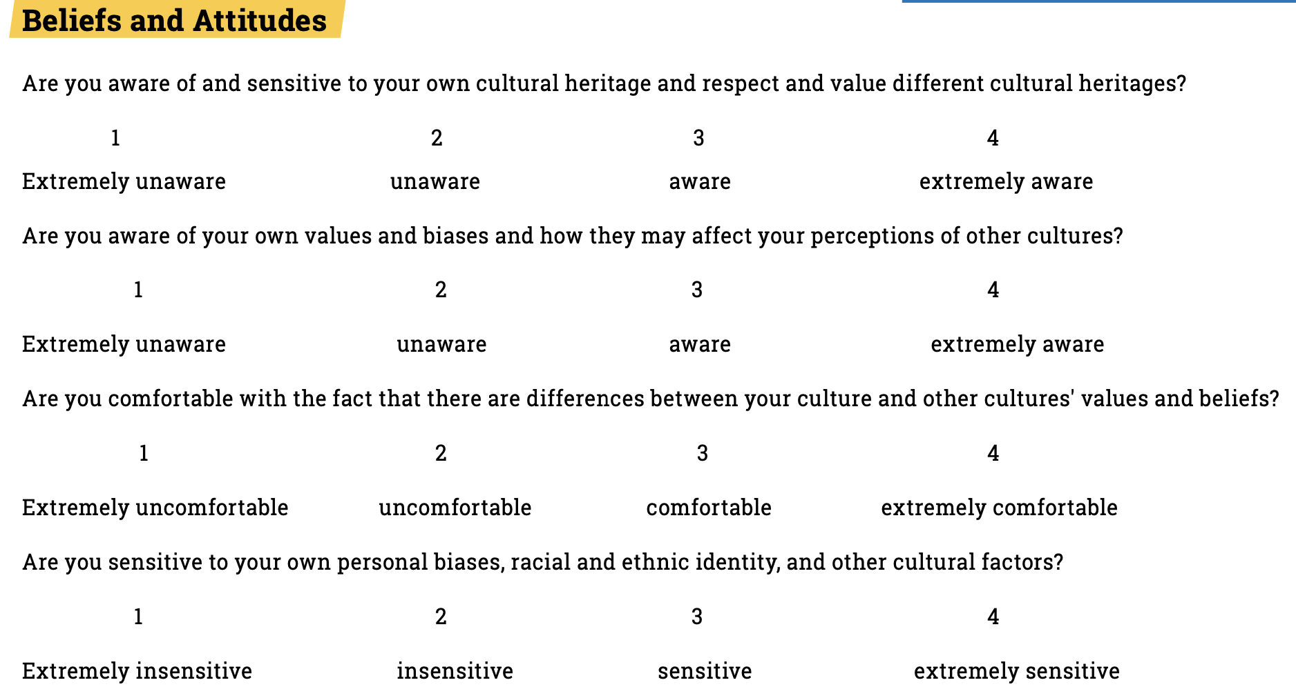

Slide 20
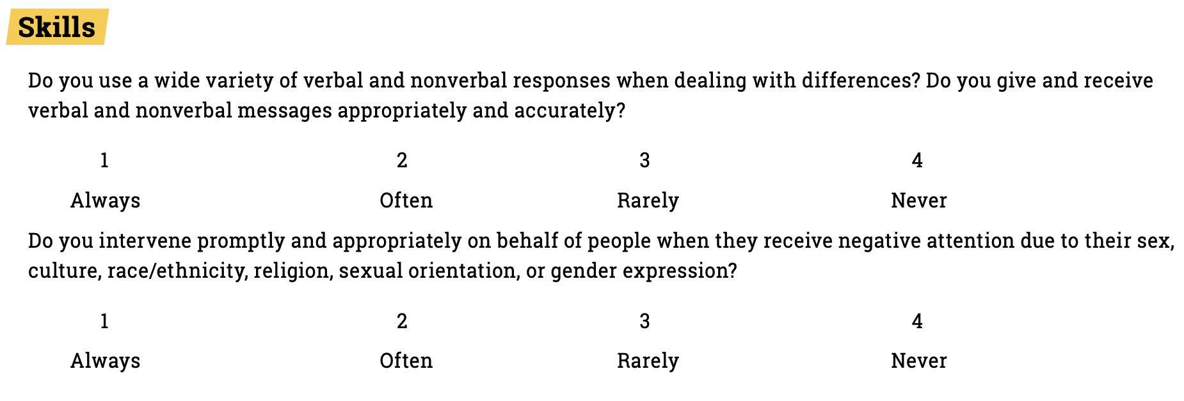

Slide 21
By acknowledging privilege, we can understand its impact on marginalized young people and systemic barriers they face as a group that does not possess a particular privilege, creating inequity.
This section outlines ways that health professionals can increase their support via a trauma-informed lens.

Slide 22
Cultural responsiveness requires taking action that ensures a health equitable environment for all young people. This action is twofold: 1) assess the policies and procedures of your organization according to National CLAS Standards, and 2) evaluate the internal climate of your organization. A CLAS Assessment will support you in reaching progress toward the inclusion of all young people in your organization.

Slide 24
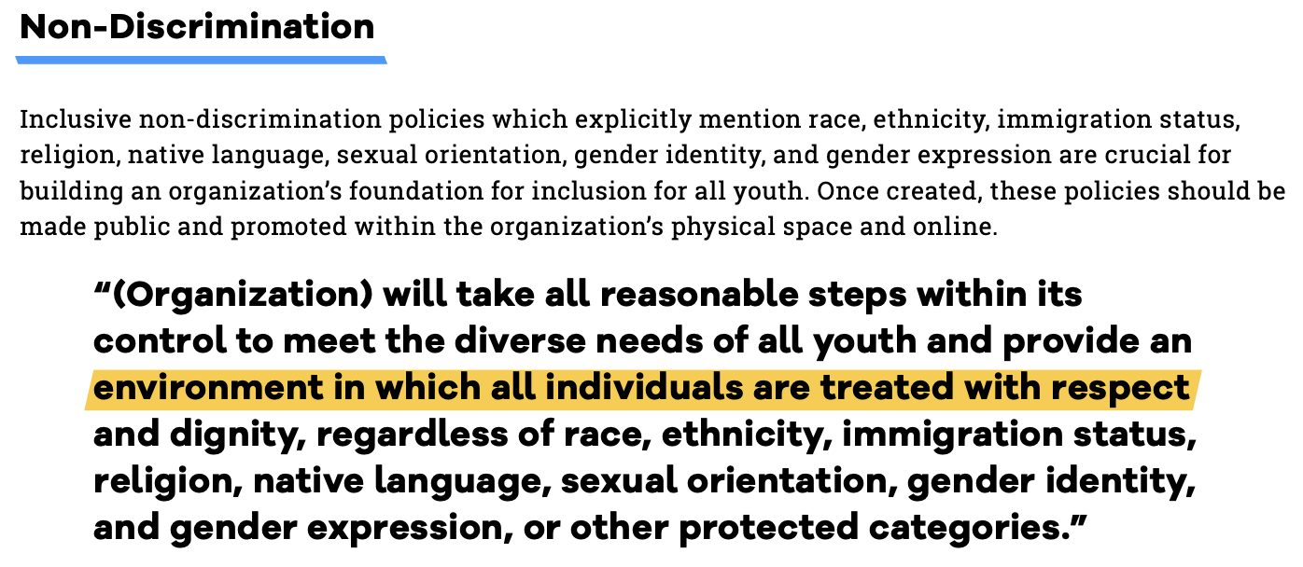
Provides sample policies that may be helpful when striving toward cultural responsiveness. Which of these does your organization have in place? What steps can be taken to implement ones that are not in place? For those that are in place, are all staff fully aware of and in compliance with these policies?

Slide 25
Once you have a solid policy foundation, it’s also important to continuously ensure that your practices reflect the values and policies of the organization.

Slide 26
GROUPBREAKOUT
Identify a facilitator
Identify a note taker
Answer questions honestly and remember there are no “right” or “wrong” answers
Putting Into Practice Worksheet

Slide 27
Youth Services and Support (in-person or digital)
Assess your policies, website, forms, and interpersonal communication to ensure appropriate and inclusive terms are being used. It is important to let people decide how they want to be identified. For instance, while these are recommendations, some people do not prefer people-first language.

Slide 28
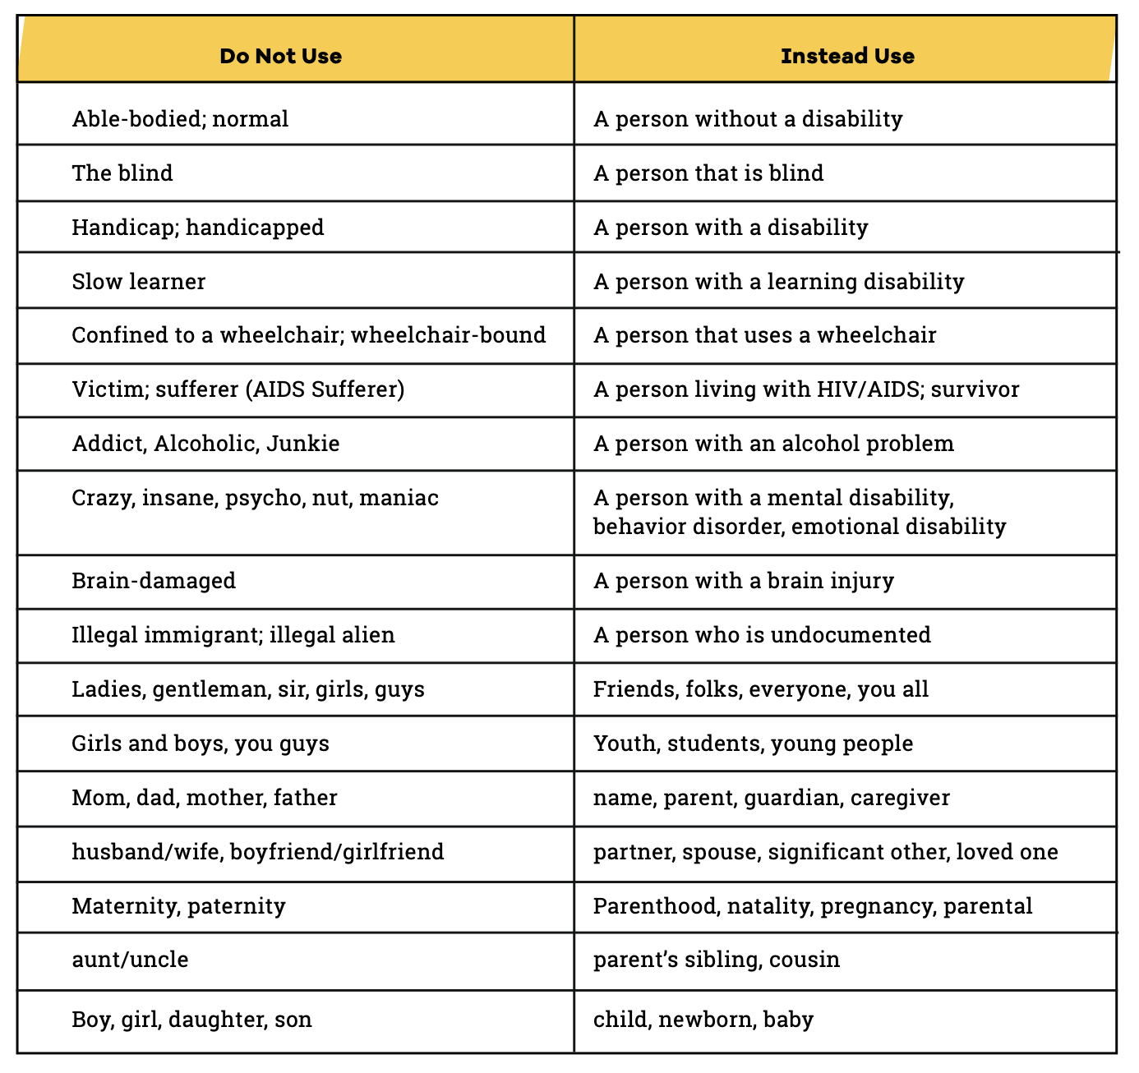
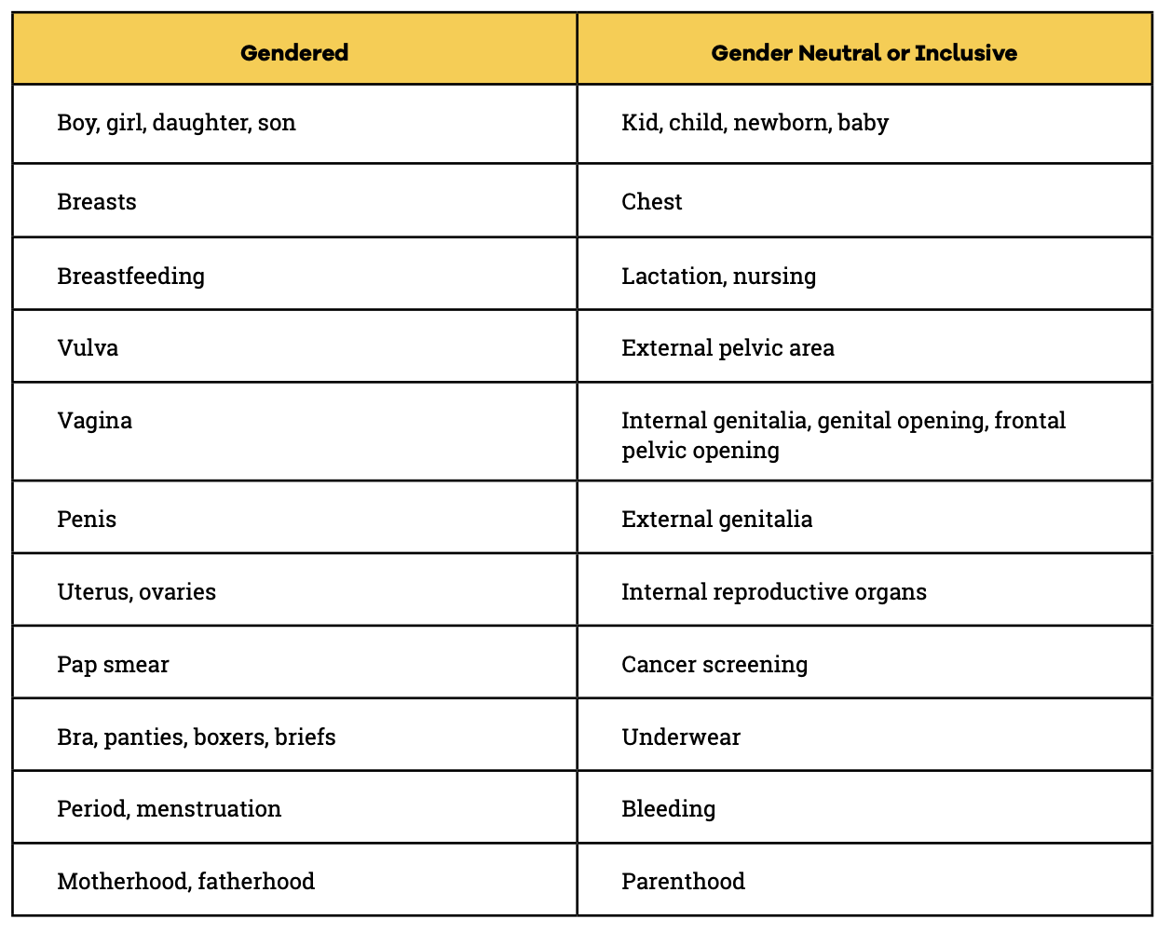

Slide 29
WEEK 10: CREATING CULTURALLY RESPONSIVE PROGRAMS
Creating programs inclusive of and sensitive to minority young people is not tricky, but it requires conscientious attention and thorough training for all staff. It is also essential to note intersectionality of identities significantly impacts youth’s ability to connect with programming; representation matters. The section provides suggestions could help to create culturally responsive programs.
WEEK 11: MEETING THE COMMUNICATION NEEDS OF YOUNG PEOPLE
Programs that support the elimination of health disparities incorporate culturally responsive components into their activities and materials. It is important to ensure that programs include linguistically appropriate services, especially around language and accessibility.

Slide 30
WEEK 12: THINGS TO CONSIDER WHEN CREATING DIGITAL SAFER SPACES
Include your pronouns in your email signature, and if possible, in your username when hosting webinars
Update webpages and social media to include and promote information about youth from culturally different backgrounds, LGBTQ youth, especially on crucial awareness days and heritage months such as weeks such as Black History Month (February), Pride Month (June), Latinx Heritage Month (October), Transgender Awareness Week (November 13-19).
Incorporate LGBTQ-inclusive symbols (rainbows, pins, etc.) in your physical surroundings while on webinars.
Name that, although digital, the space (whether webinar or meeting) is intended to be inclusive of everyone and their identities.
Keep in mind that young people are focused on technology. Are your web pages updated? Do your web pages include culturally competent images, etc.? What type of reviews do you have as an agency?
Ensure that web pages, including social media channels, are up to date, active, and culturally competent. Remember to include Frequently Asked Questions and Resources sections.

Slide 31
GROUPACTIVITY
Grits are better with sugar or salt.
Pineapples belong on pizza.
Candy corn reminds me of Halloween.

Slide 32
TAKEAWAYS
1. Be Clear about Your Own Attitudes and Biases.
2. Understand How Discrimination, Including Racism, Homophobia, and Transphobia Affect Youth.
3. Take Action to Ensure All Young People Feel Affirmed at Your Organization.
4. Support Youth and Staff in Your Agency to Be in Support of Young People from Marginalized Backgrounds

Slide 33
QUESTIONS
& COMMENTS

Slide 34
Armonté Butler
armonte@advocatesforyouth.org
louie ortiz-fonseca
louie@advocatesforyouth.org

